Slide 1
Linear and Ensemble Methods
CSCI 4360/6360 Data Science II

Slide 2
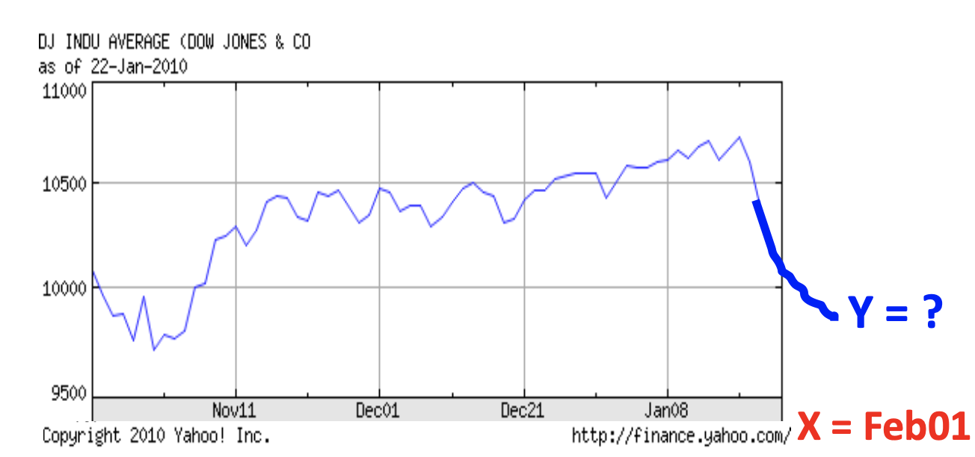
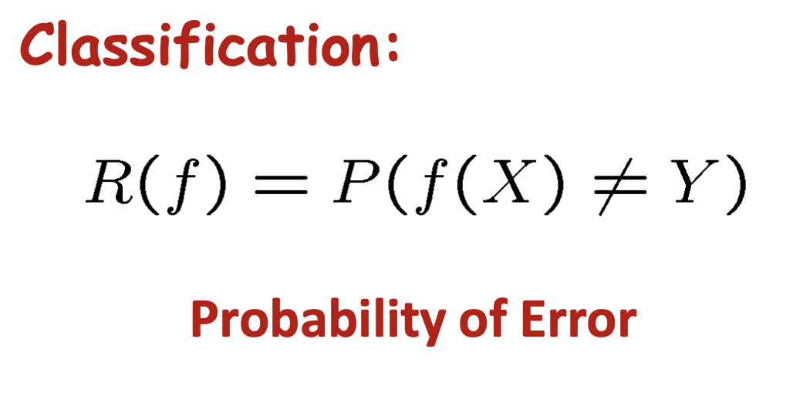
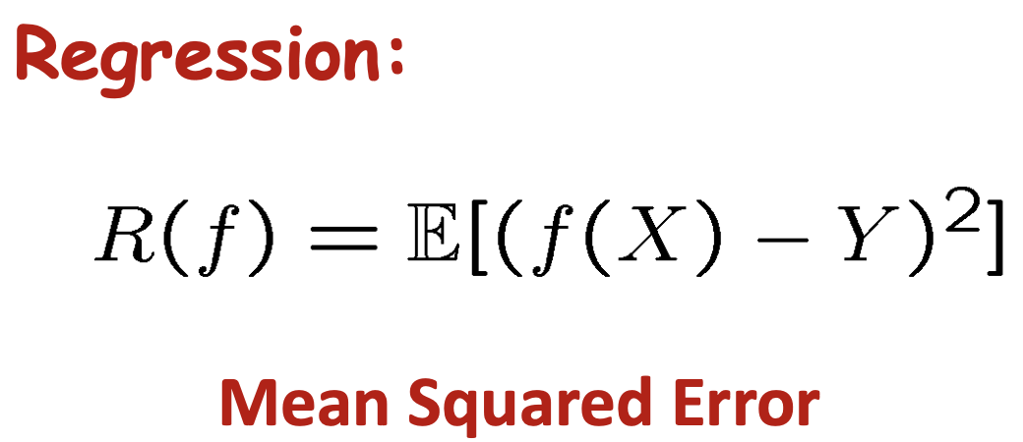
In general, the goal:
Construct a predictor f: X -> Y that minimizes risk R(f)
Notes:
Risk – the probability of our estimator f making a mistake
We want to minimize the risk as much as possible
Though true risk is something we usually don’t have access to

Slide 3
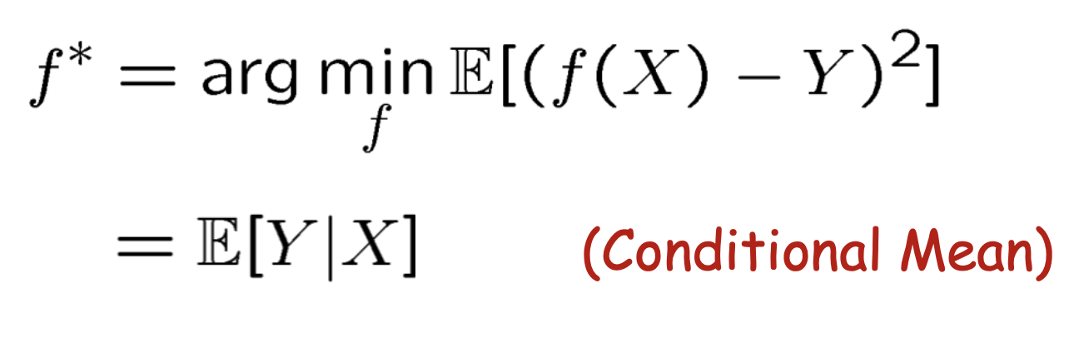
Optimal [regression] predictor
Notes:
Take the risk function for regression, throw in an arg min, and you have the *optimal* regressor
”optimal” meaning it has the lowest risk, ie makes the fewest mistakes
Rewrite as an expectation over Y (the prediction), conditioned on X (the data)

Slide 4
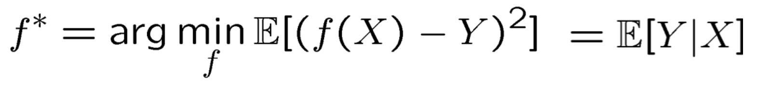
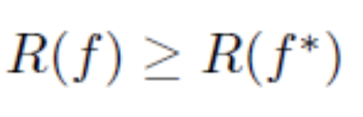
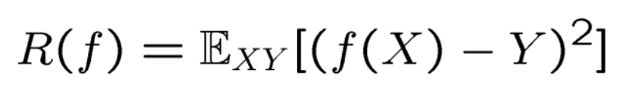
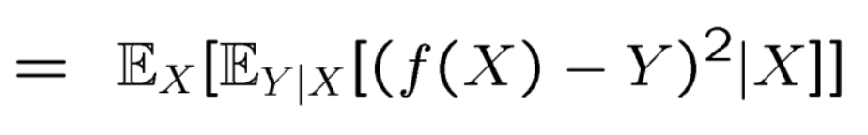
We can prove this!
Therefore, for any prediction rule f
We define R(f)
Expand according to axiom of conditional probability
Notes:
So if f* is the predictor with the lowest risk
The risk of any other predictor f will, necessarily, be AT BEST the same as f*, or larger (ie more error)
Then some algebra, courtesy of the axiom of conditional probability

Slide 5
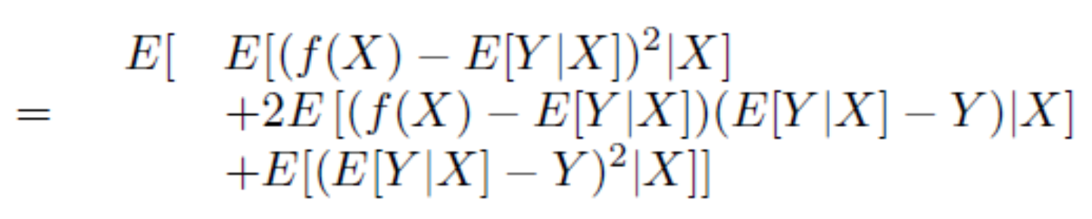
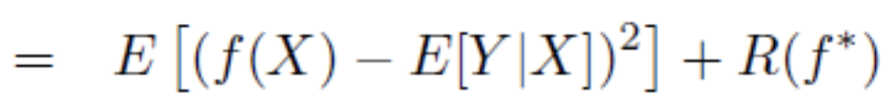
It escalates quickly…
(dropping subscripts for convenience)
Multiplying out the quadratic term
Notes:
Copy the last equation of the previous slide to the first one here
Add AND subtract the same term (E[Y|X]), so the actual value hasn’t changed
But this allows us to foil out the square term nicely, and in such a way that lots of terms cancel
Left with: an expectation, and a constant

Slide 6
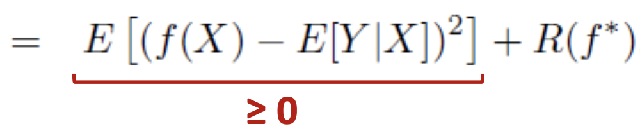
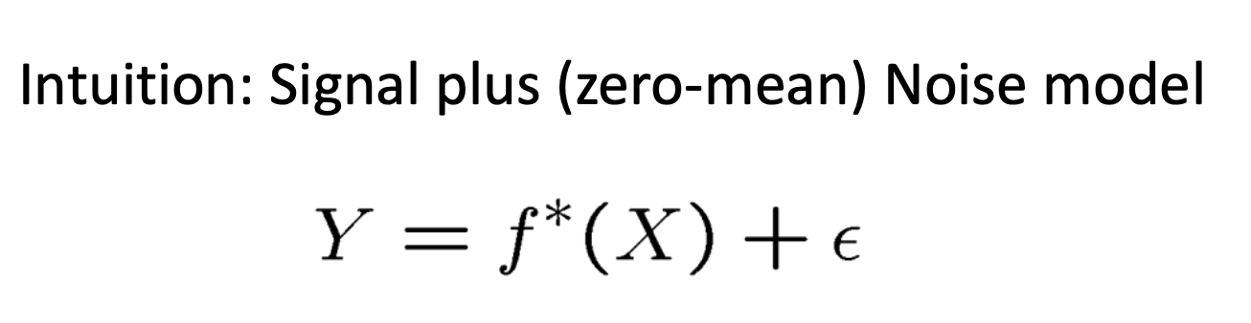
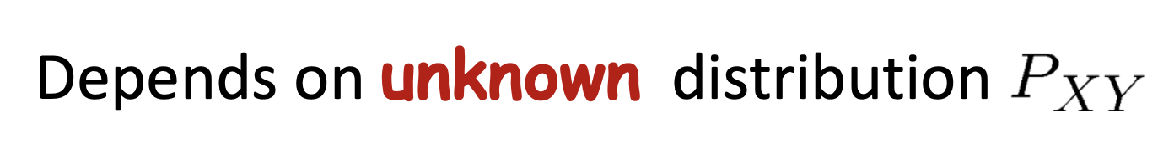
Finally…
Notes:
Signal plus noise! (anytime you see [variable + constant], think: signal + noise)
Of course this whole thing depends on the unknown distribution Pxy, courtesy of not knowing the true / optimal risk

Slide 7
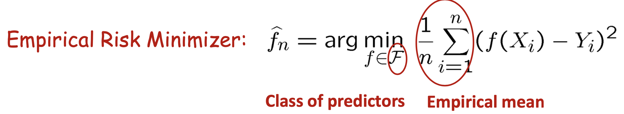
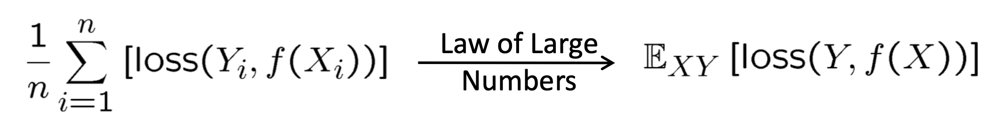
Empirical Risk Minimization (EMR)
Since we don’t have direct access to the unknown distribution P(X, Y), we rely on statistics
Notes:
We can, however, calculate empirical risk: use the data we have and some class of predictors to determine the one that makes the fewest mistakes for that dataset
(does this sound like data science? I think so!)
Anyone know law of large numbers?
Average of a large enough collection of numbers converges at the limit to the *true* average
So with enough data, the empirical risk converges to the true risk

Slide 8
Part I: Linear Models

Slide 9
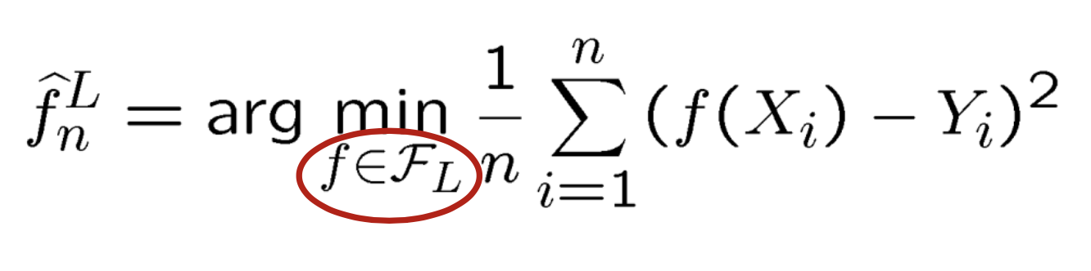
Linear Models
Means each f in F_{L} is restricted to a class of linear functions (in X)
Notes:
Here’s our empirical risk function, but now we’ve constrained f to be ONLY linear models
(can you name a few?)

Slide 10



Slide 11
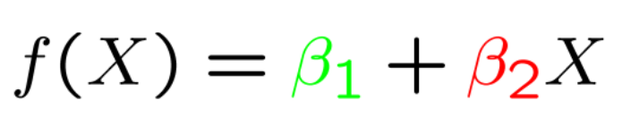
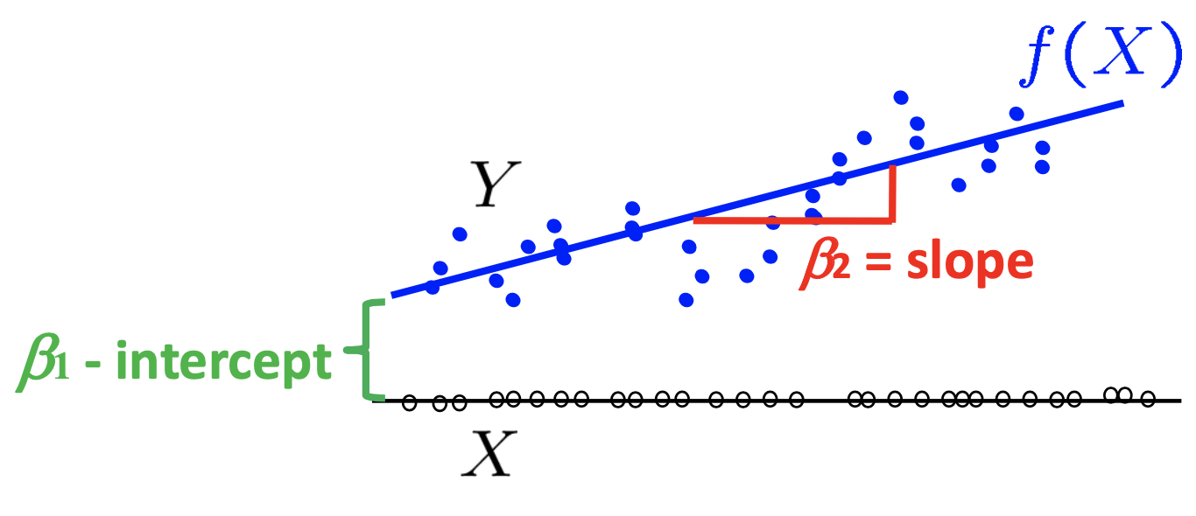
Univariate case
You’ve seen this a million times…
Notes:
Usually we use mx + b, but b is b1 and m is b2 for consistency in the next few slides

Slide 12
Multivariate case
where
Notes:
…ie right here
For 3 and larger dimensions, this generalizes to planes and hyperplanes by simply adding more b terms, but the general form of the equation stays the same
(ie a line, in higher dimensions)
Drop the subscripts to reference vectors instead
Each b is a scalar, each Xp is a VECTOR (a point in high dimensional space)
So X is a MATRIX

Slide 13
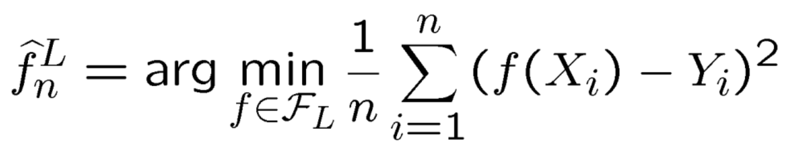
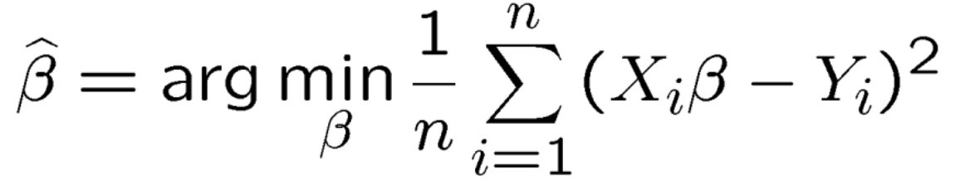
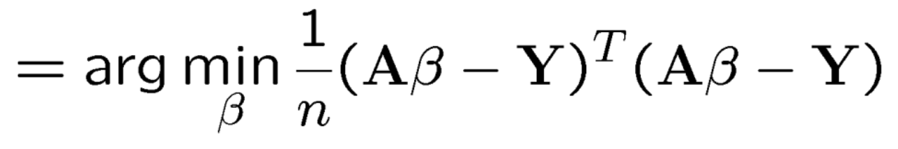
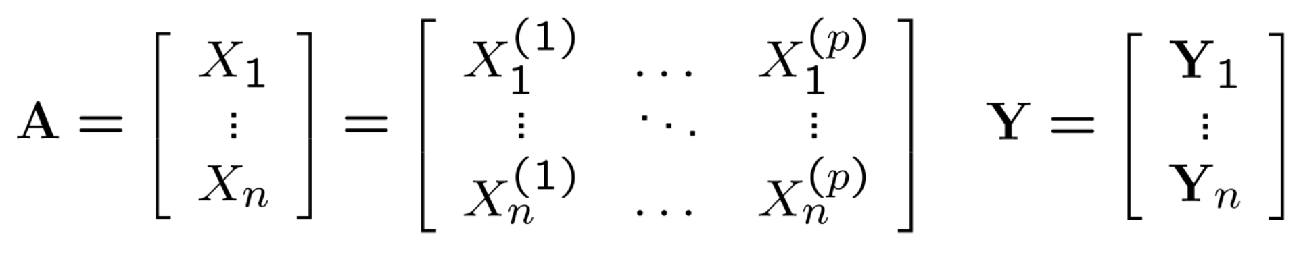
Finding the estimator
Back to our original equation
Substitute in our line parameters
Expand the square
where
Notes:
Rewrite the original risk minimization in terms of these coefficients
Rewrite the sum in terms of matrix multiplication
A is a vector of vectors, ie a matrix
Y is also a vector of vectors, ie another matrix
Squares in matrix algebra have this AtA or AAt look

Slide 14
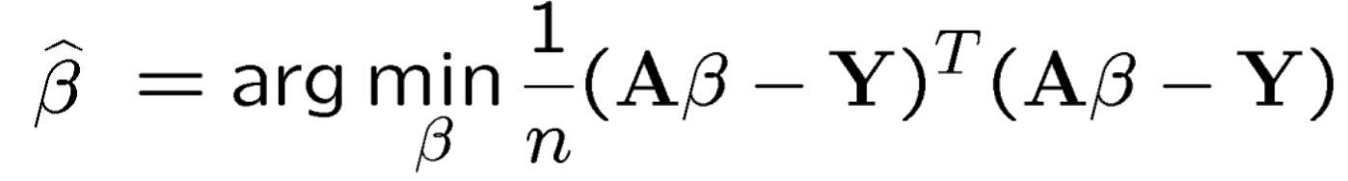
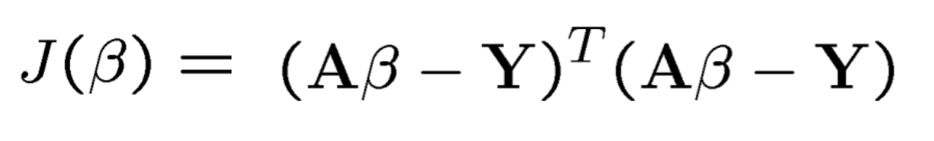
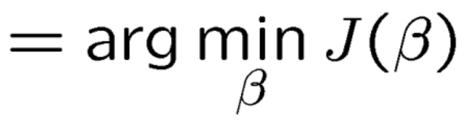
Finding the estimator
Notes:
We want the b that minimizes the total value of the equation (since that represents a closer fit to Y)
Can change this into a function of b that we want to minimize (since we know how to minimize functions… right???)

Slide 15
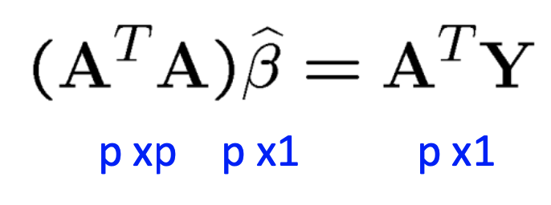
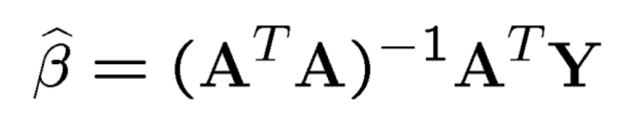
Normal Equations
If (A^{T}A) is invertible, this is easily solved!
When is (A^{T}A) invertible?
When A is full rank (recall Linear Algebra Review lectures)
Notes:
If we take the derivative and set it equal to 0, we get the normal equation
Assuming AtA is invertible, we can solve DIRECTLY for b, no optimization needed!
(when is AtA invertible? Recall linalg crash course lectures)

Slide 16
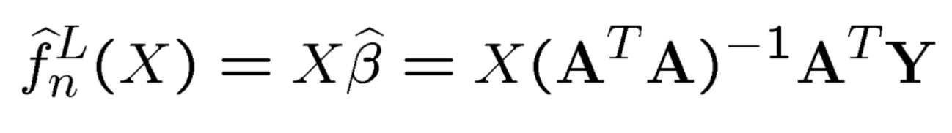
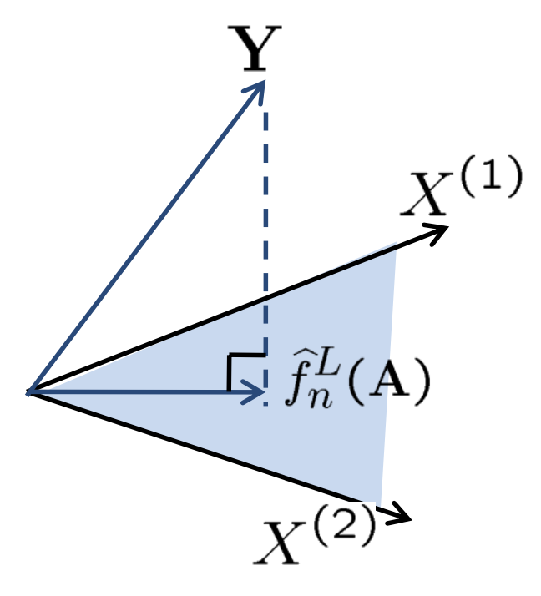
Geometric Interpretation
f_{n}(A) is the orthogonal projection of Y onto the linear subspace spanned by the columns of A (aka X)
(go back and review the Linear Algebra notes!)
Notes:
We can think of this geometrically, again from our linear algebra crash course
F(A) is the projection—or transformation—of Y onto the subspace spanned by the columns of X
Remember that matrices are mappings from one space to another!
X spans a space, Y spans a space, and f(A) maps Y onto X

Slide 17
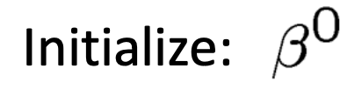
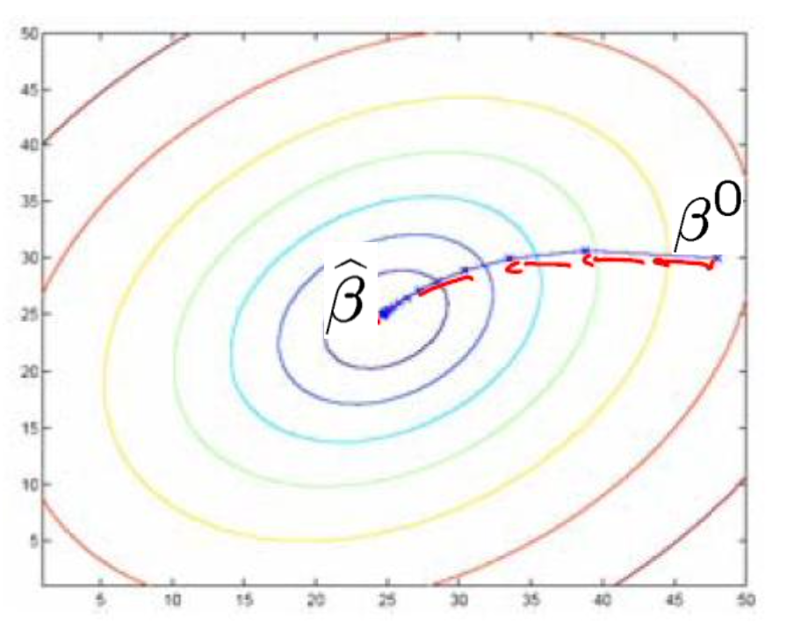
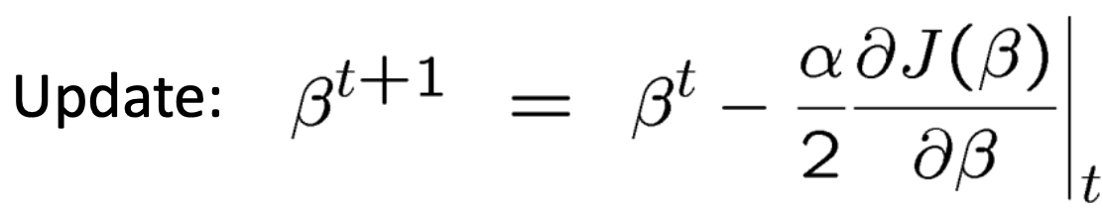
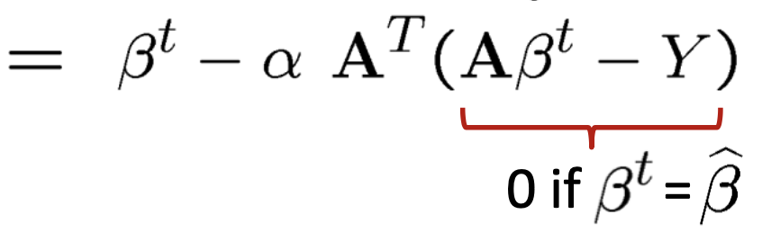
Normal Equations
We saw how to solve when (A^{T}A) is invertible
Unspoken was the assumption that it is also small
What about when (A^{T}A) is invertible, but very large?
Gradient descent! J(β) is convex!
Notes:
“small” in terms of the number of rows / columns
Inversion is an O(n^2) computation at best, sometimes degrading to n^3 under certain conditions
For all but very small n, this is infeasible
In these cases, we can do gradient descent
Full rank just means there is one and only one solution
As long as we don’t butcher the gradient descent process (how?), it should converge

Slide 18
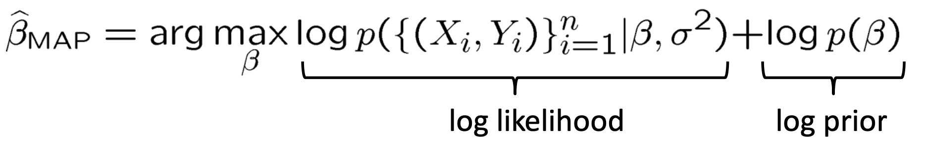
Normal Equations
What about when (A^{T}A) is not invertible?
Prior + regularization
Notes:
Maximum a posteriori (MAP) estimator
Is to Bayesian statistics what maximum likelihood (MLE) is in frequentist stats
Apply a prior that *is* invertible, compute the likelihood, then find the b that maximizes that likelihood

Slide 19
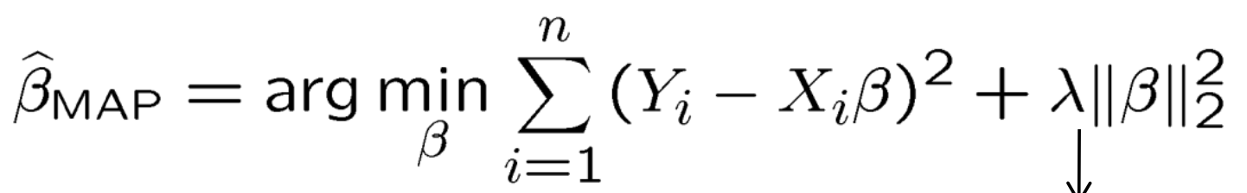
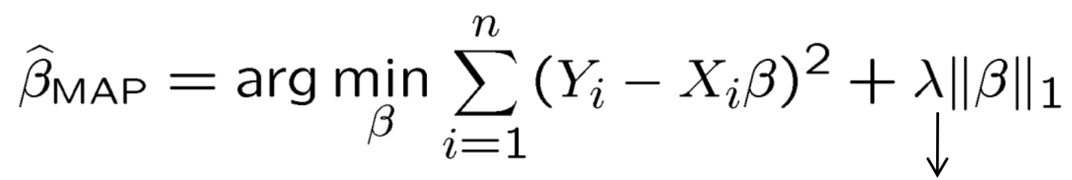
Non-invertible case
What kinds of priors?
Gaussian prior
Laplace prior
What’s the difference?
Notes:
Priors act as regularizers (what are those? Different types?)
What is the difference in this case between choosing a gaussian vs laplace prior? (note the exponents)

Slide 20


Slide 21
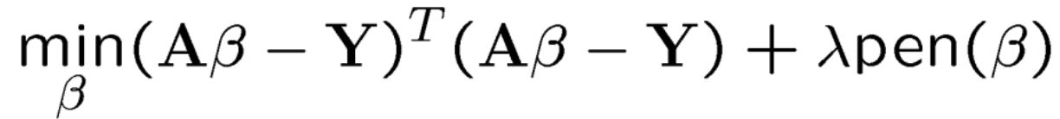
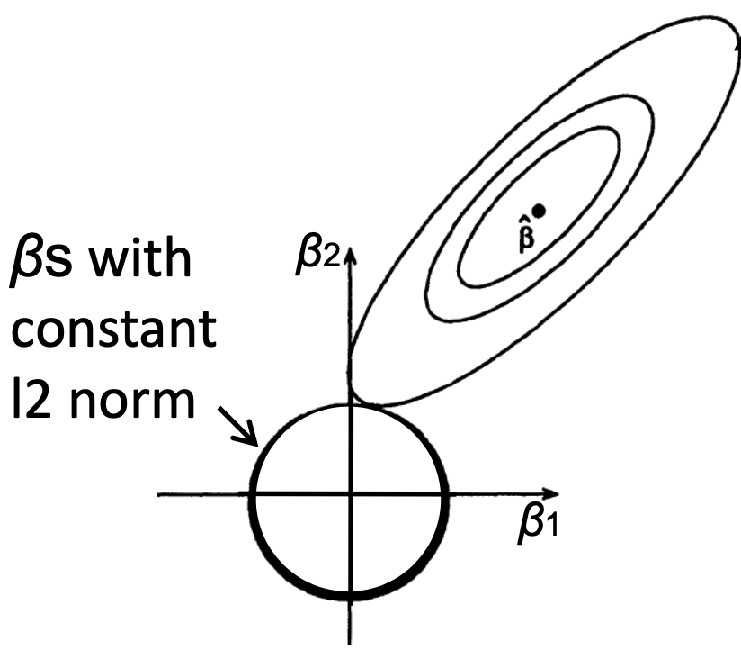
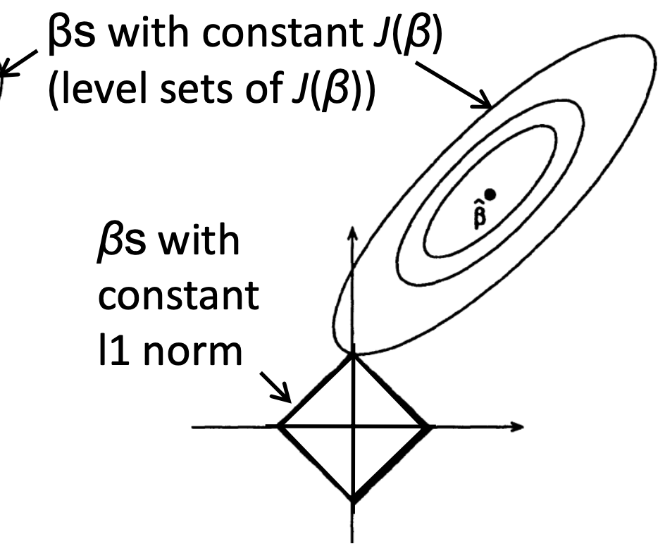
Types of regularization
Ridge regression (L2)
Lasso regression (L1)
L1 (Lasso) results in sparse solutions
Very good for high-dimensional problems!
Notes:
L1 favors sparse solutions, ie most of the components of the b vector will be 0 (and more are driven to 0 as more weight is applied to the prior, making solutions sparser)
L2 favors more exact solutions, but as a result few if any b coefficients will be 0 (why is this problematic?)

Slide 22
Part II: Ensemble Models

Slide 23
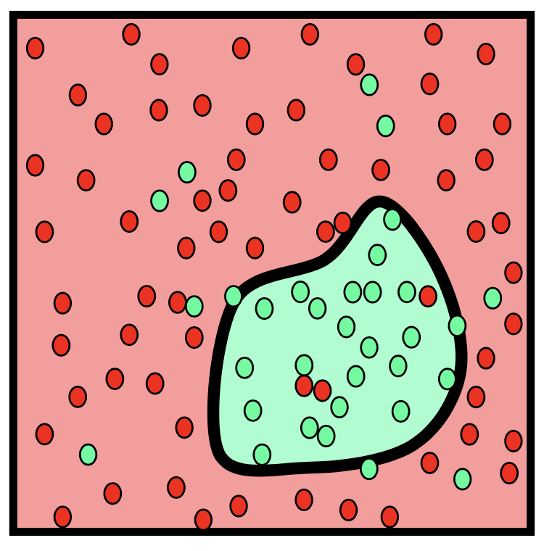
Nonlinear decision boundaries
Sometimes we encounter problems that linear models can’t solve
Notes:
Linear models are great because lines have simple coefficients we can inspect
Larger coefficients = more important
0 coefficient = we can ignore this / it’s not important
Some data are nonlinear; there’s no line to separate green from red

Slide 24
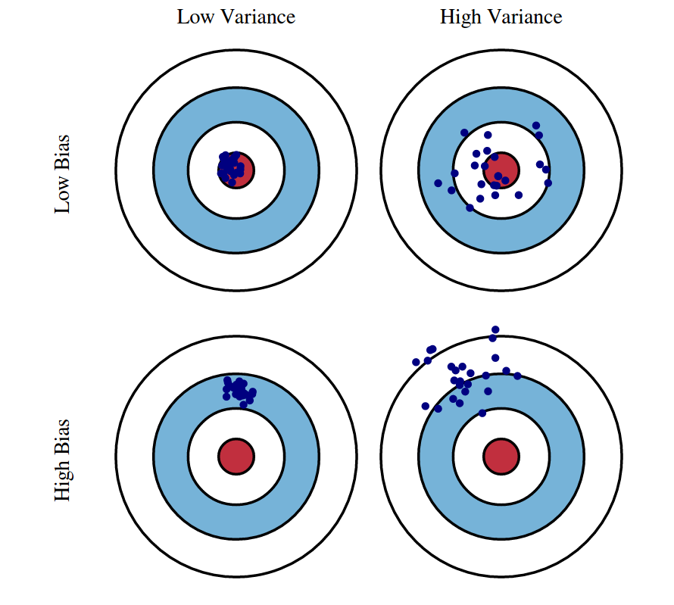
Bias-variance trade-off
Bias
E[θ – X]
Deviation of the estimator from the true value on average
Variance
E(X²) – E(X)²
Spread of the data from its average
As one decreases, the other tends to increase
Low-bias, low-variance is not generally possible
Notes:
We need something more powerful than a simple linear model
Anytime you move up the “model complexity” chain (especially if you’re considering deep models), bias-variance is something you NEED to consider

Slide 25
Ensemble Models
Collections of “weak learners”
Decision Trees -> Random Forests
Logistic Regression -> Pool of Logistic Regressors
Naïve Bayes -> Ensemble of Naïve Bayes
Support Vector Machine -> Ensemble of SVMs
Each is trained independently on a subset of the training data
Decisions are made by pooling all the individual models’ predictions
Instead of learning a single (weak) classifier, learn many (weak) classifiers that are good at different parts of the input space
Notes:
Ensemble models aren’t quite nonlinear models; they’re groups of “weak learners” (aka linear models, SVMs notwithstanding) that work together
Final decision of the complete model is a function of the individual decisions of each weak learner
Weak learners “specialize” in different parts of the data space, emphasizing different aspects a single monolithic model would miss

Slide 26
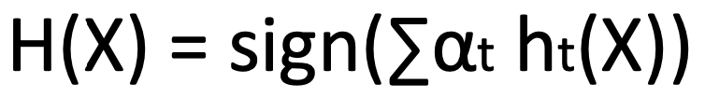
Boosting
Given a weak learner, run it multiple times on (reweighted) training data, then let learned classifiers vote
On each iteration t:
weight each training example by how incorrectly it was classified
learn a weak hypothesis (classifier) h_{t}
a strength of the hypothesis ɑ_{t}
Final classifier
Notes:
Boosting reweights the learners to specialize in different areas
Final classifier is a weighted sum of the individual classifications

Slide 27
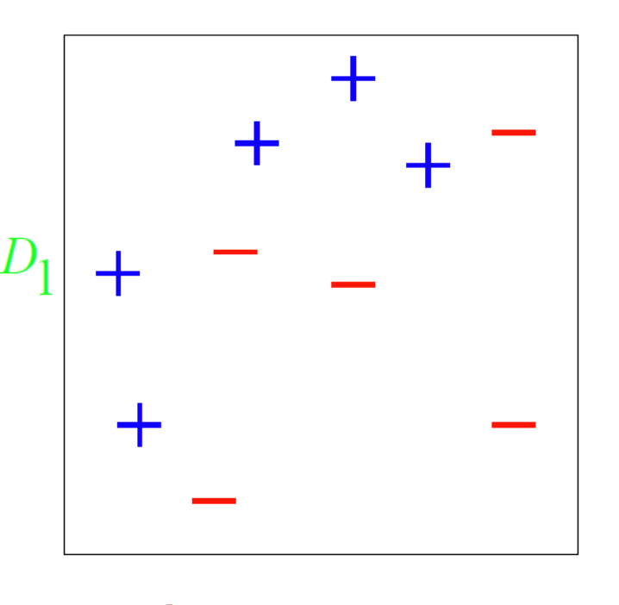
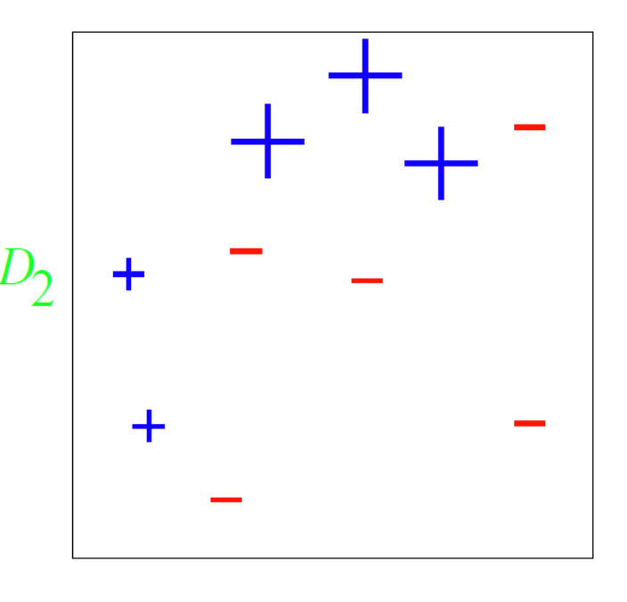
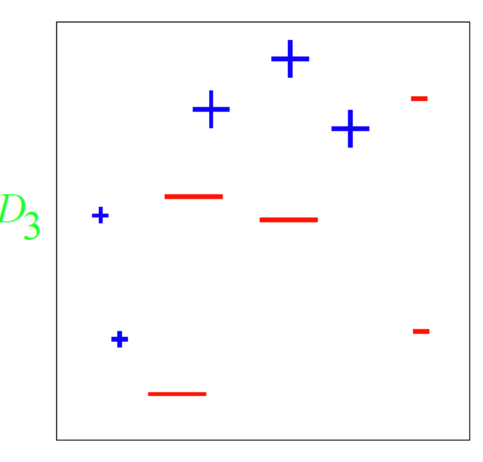
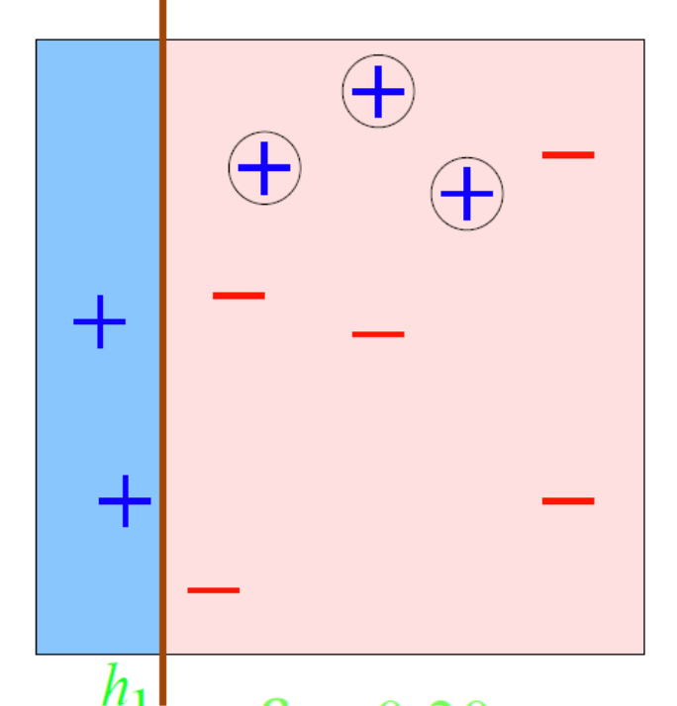
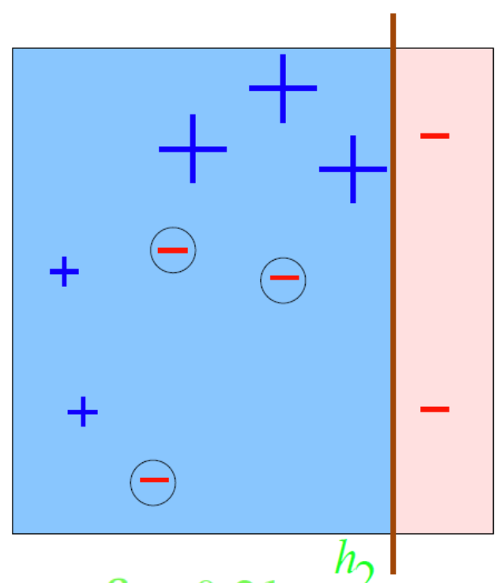
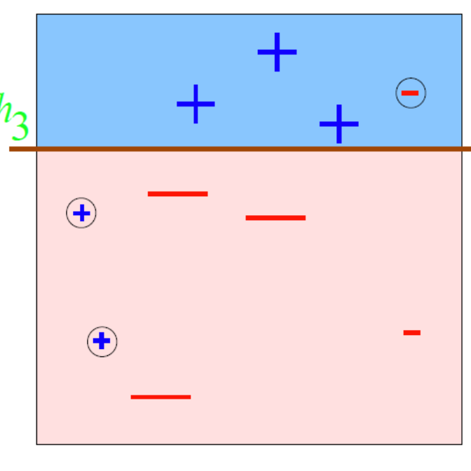
Boosting example
Notes:
Error decreases on each iteration as a function of the _reweighted_ data
Train a classifier, upweight the data it got wrong / downweight data it got right
Train a new classifier (with reweighted data), reweight data
Continue until some threshold is reached

Slide 28
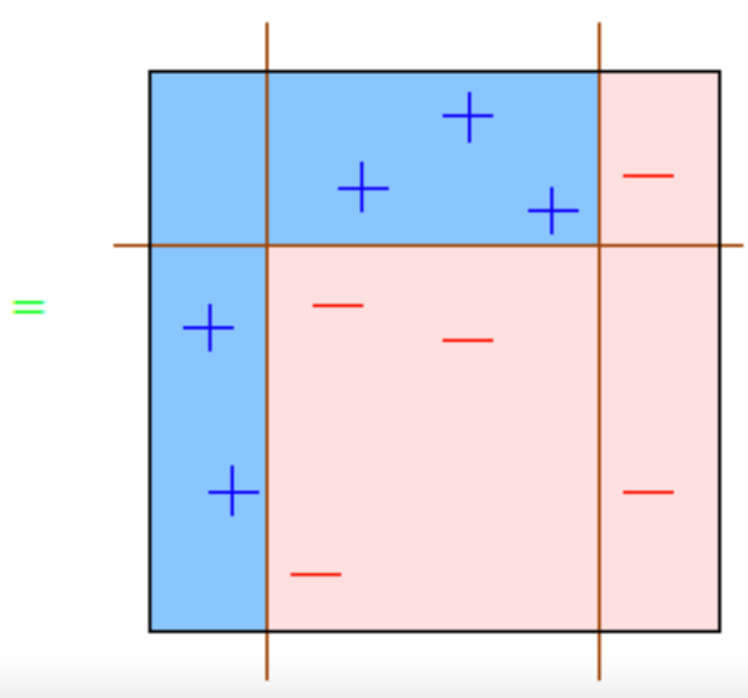
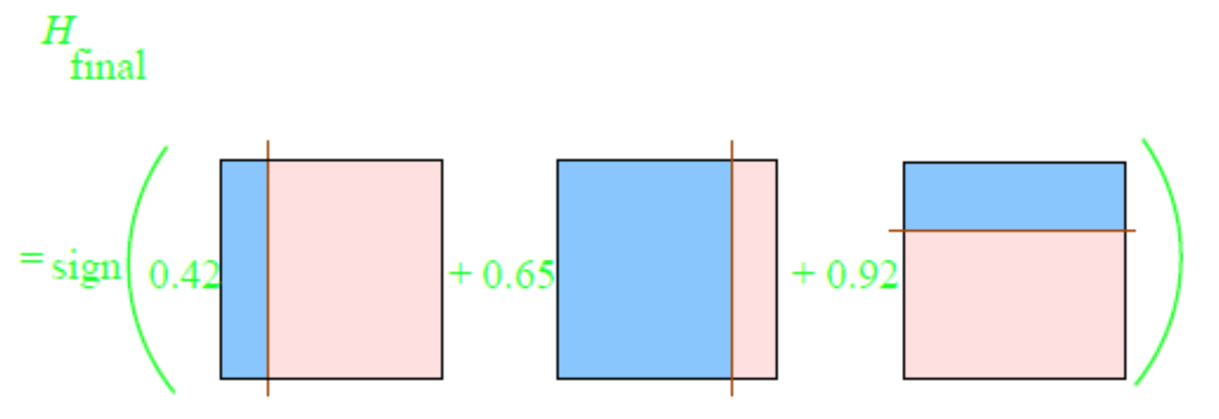
Boosting example
Notes:
Final classifications are weighted according to individual accuracies and weights, summed across all learners and data points
Still a linear model! But more powerful and specialized than a single linear model could manage on its own
Some version of an ensemble is often state-of-the-art in most areas. Kaggle is a great example: top performers are usually ensembles (of deep learners, granted, but still)

Slide 29
Part III: xgboost
Notes:
The pinnacle of ensembles

Slide 30

XGBoost
eXtreme Gradient Boosting
29 Kaggle challenges with winners in 2015
17 used XGBoost
8 of these solely used XGBoost; the others combined XGBoost with DNNs
KDDCup 2015
Every single top 10 finisher used XGBoost
Notes:
Just before the deep learning wave hit, ensembles via xgboost were the rage.
Still can usually achieve performance that is close to deep (non-ensemble) models

Slide 31
XGBoost Applications
Store sales prediction
High energy physics event classification
Web text classification
Customer behavior prediction
Motion detection
Ad click through rate prediction
Malware classification
Product categorization
Hazard risk prediction
Massive on-line course dropout rate prediction

Slide 32
Properties of XGBoost
Single most important factor in its success: scalability
Due to several important systems and algorithmic optimizations
Highly scalable end-to-end tree boosting system
Theoretically justified weighted quantile sketch for efficient proposal calculation
Novel sparsity-aware algorithm for parallel tree learning
Effective cache-aware block structure for out-of-core tree learning
Notes:
Not even the latest deep learning libraries can say all four of these points (how often do you hit OOM errors in PyTorch…)
If nothing else, xgboost is an AMAZING first-pass at a problem

Slide 33


What is “tree boosting”?
Given a dataset (n examples, m features)
Tree ensemble uses K additive functions to predict output
Notes:
F is the space of regression trees
Structure of each tree q maps an example to corresponding leaf index; each f_k is an independent tree structure and leaf weights w
Each q maps m-feature data point to T leaves
Regression trees contain a continuous score on each leaf, and w_i is the score on the i^th leaf (unlike decision trees)

Slide 34
What is “gradient boosting”?
Notes:
If you’ve ever used decision trees, here’s where they diverge most clearly from gradient boosted trees
We split / fit based on residuals, rather than on eg information maximization
Each tree models a different part of the error—more trees, more error modeled, more accurate final reconstruction / prediction (though more trees also means more computation, but it scales linearly)

Slide 35
Split-finding algorithms
Exact
Computationally demanding
Enumerate all possible splits for continuous features
Approximate
Algorithm proposes candidate splits according to percentiles of feature distributions
Maps continuous features to buckets split by candidate points
Aggregates statistics and finds best solution among proposals
Notes:
Most gradient boosted trees use approximate algorithms for speed and scalability, and often lose very little in terms of accuracy

Slide 36

Comparison of split-finding
Two variants
Global
Local
Notes:
The global variant proposes all the candidate splits during the initial phase of tree construction, and uses the same proposals for split finding at all levels. The local variant re-proposes after each split.
The global method requires less proposal steps than the local method. However, usually more candidate points are needed for the global proposal because candidates are not refined after each split.
The local proposal refines the candidates after splits, and can potentially be more appropriate for deeper trees. A comparison of different algorithms on a Higgs boson dataset is given by Fig. 3. We find that the local proposal indeed requires fewer candidates. The global proposal can be as accurate as the local one given enough candidates.

Slide 37

Sparsity-aware split finding
Equates sparsity with missing values
Defines a “default” direction: follow the observed paths
Compare to “dense” method
Notes:
Benefits of data sparsity: speed!
Many large-scale algorithm implementations leverage sparsity as a key assumption underlying their scalability. If data are not sparse, overall performance suffers

Slide 38
How does this work?
Features need to be in sorted order to determine splits
Concept of blocks
Compressed column (CSC) format
Each column sorted by corresponding feature value
Exact greedy algorithm: all the data in a single block
Data are sorted once before training and used subsequently in this format

Slide 39

Feature transformations in blocks

Slide 40
More on blocks
Data is stored on multiple blocks, and these blocks are stored on disk
Independent threads pre-fetch specific blocks into memory to prevent cache misses
Block Compression
Each column is compressed before being written to disk, and decompressed on-the-fly when read from disk into a prefetched buffer
Cuts down on disk I/O
Block Sharding
Data is split across multiple disks (i.e. cluster)
Pre-fetcher is assigned to each disk to read data into memory

Slide 41
Cache-aware access
Exact Greedy Algorithm
Approximate Algorithms
Allocate an internal buffer in each thread
Fetch gradient statistics
Perform accumulation in mini-batch
Reduces runtime overhead when number of rows is large
Choice of block size is critical
Small block size results in small workloads for each thread
Large block size results in cache misses as gradient statistics do not fit in cache

Slide 42


Cache-aware access
Exact
Approximate

Slide 43

Results: out of core
Notes:
Comparison of out-of-core methods on different subsets of criteo data. The missing data points are due to out of disk space. We can find that basic algorithm can only handle 200M exam- ples. Adding compression gives 3x speedup, and sharding into two disks gives another 2x speedup. The system runs out of file cache start from 400M examples. The algorithm really has to rely on disk after this point. The compression+shard method has a less dramatic slowdown when running out of file cache, and exhibits a linear trend afterwards.

Slide 44


Results: distributed
Notes:
Comparison of different distributed sys- tems on 32 EC2 nodes for 10 iterations on different subset of criteo data. XGBoost runs more 10x than spark per iteration and 2.2x as H2O’s optimized ver- sion (However, H2O is slow in loading the data, get- ting worse end-to-end time). Note that spark suffers from drastic slow down when running out of mem- ory. XGBoost runs faster and scales smoothly to the full 1.7 billion examples with given resources by utilizing out-of-core computation.
Finally, we evaluate the system in the distributed setting. We set up a YARN cluster on EC2 with m3.2xlarge ma- chines, which is a very common choice for clusters. Each machine contains 8 virtual cores, 30GB of RAM and two 80GB SSD local disks. The dataset is stored on AWS S3 instead of HDFS to avoid purchasing persistent storage.

Slide 45

Results: scalability

Slide 46
Conclusions
Most (all?) supervised models are predicated on minimizing risk
Linear models do this by fitting coefficients
Can be solved directly (with an inverse)
Can be solved iteratively (with gradient descent)
Regularization can help with fitting but has trade-offs
Linear models are inherently limited but their utility need not be sacrificed thanks to ensemble models
Bias-variance trade-off
Boosting; not to be confused with gradient-boosted trees (xgboost)
Combination of algorithmic design and clever hardware implementations make for an easy-to-use and extremely performant ensemble model

Slide 47
References
Elements of Statistical Learning, Chapters 3, 9, and 10
Xgboost: A Scalable Tree Boosting System
http://arxiv.org/abs/1603.02754
Xbgoost demo: https://arogozhnikov.github.io/2016/06/24/gradient_boosting_explained.html

Slide 49

Regularized objective function
Notes:
I_j is the instance set of leaf j.

Slide 50





Regularized objective function
Objective
2nd order approx.
Remove constants
Scoring function to evaluate quality of tree structure
Notes:
Here l is a differentiable convex loss function that measures the difference between the prediction yˆi and the target yi. The second term Ω penalizes the complexity of the model (i.e., the regression tree functions) (T is number of leaves, w the weights).
The additional regularization term helps to smooth the final learnt weights to avoid over-fitting
Intuitively, the regularized objective will tend to select a model employing simple and predictive functions
A similar regularization technique has been used in Regularized greedy forest (RGF) [25] model.
Our objective and the corresponding learning algorithm is simpler than RGF and easier to parallelize. When the regularization parameter is set to zero, the objective falls back to the traditional gradient tree boosting.
This score is like the impurity score for evaluating decision trees, except that it is derived for a wider range of objective functions.

Slide 51
Shrinkage and column subsampling
Shrinkage
Scales newly added weights by a factor $η$
Reduces influence of each individual tree
Leaves space for future trees to improve model
Similar to learning rate in stochastic optimization
Column subsampling
Subsample features
Used in Random Forests
Prevents overfitting more effectively than row-sampling

